Slide 1
CIPD Coronavirus webinar series
Returning to the workplace: hybrid working
22 April 2021

Slide 2
Welcome
Lee Ann Panglea, Head of CIPD Scotland and Northern Ireland, CIPD

Slide 3
Today’s speakers
Lee Ann Panglea
Head of CIPD Scotland and Northern Ireland, CIPD
Claire McCartney
Senior Policy Adviser – Resourcing and Inclusion, CIPD
Gemma Dale
Lecturer, Liverpool John Moores University
Matt Reymes-Cole
Legal Manager, Croner

Slide 4
#StrongerWithCIPD
Covid-19 resources
NEW Well-being helpline
Employment Law helpline
Communities and branches
People Management
Knowledge and content
Free learning
Careers support
Professional creditability
Financial support
cipd.co.uk/memberbenefits

Slide 5
*New* Wellbeing Resources
We’ve partnered with Health Assured to support members mental health and wellbeing
Unlimited free 24/7 confidential telephone helpline, online portal & Health e-Hub app
The resource provides:
Legal information
Debt and financial information
Manager consultancy and support
Information on work and home issues
Factsheets, advice, information and self-help tools
Links to specialist support organisations
A resources area with; programmes, videos, webinars, medical information and mini health checks.

Slide 6
Returning to the workplace – hybrid working
Claire McCartney
Senior Policy Adviser, CIPD

Slide 7
A growing focus on hybrid working
Two-thirds (63%) of employers plan to introduce or enable more home & hybrid working over the next 6 - 12 months

Slide 8
Hybrid planning
Listen to your employees
Engage your people managers
Trial and learn from different ways of working
Put inclusion and fairness at the heart of your strategy

Slide 9
Seven strategies to make hybrid working a success
Develop the skills and culture needed for open conversations about wellbeing
Encourage boundary-setting and routines to improve wellbeing and prevent overwork
Ensure effective co-ordination of tasks and task-related communication
Pay special attention to creativity and problem-solving tasks
Build in time, including face-to-face time, for team cohesion and organisational belonging
Facilitate networking and relationships across teams
Organise a wider support network to compensate for the loss of informal learning.

Slide 10
Greater focus on other types of FW needed
Less than a third (30%) of employers are planning to try to increase the uptake of other forms of FW over the next 6-12 months

Slide 12
Introducing Hybrid Working
The 6 foundations for success - Gemma Dale @HR_Gem

Slide 13
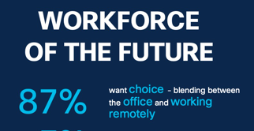
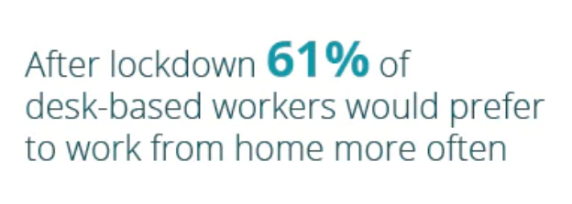
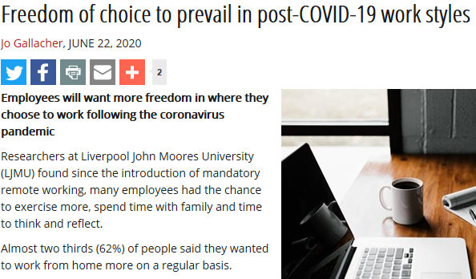
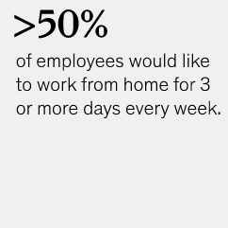

Slide 14
Where are we now?
Between the old normal and the next thing
Thinking about hybrid and new ways of working… but with few precedents
Preferences and possibilities still emerging
Interim changes regardless of strategy
Waiting……
Yesterday
Tomorrow?

Slide 15
Hybrid Working
Office (tradition)
Remote (forced)
Hybrid (choice)

Slide 16
Hybrid Working
The 6 Foundations
Trust
Communication
Technology
Outcomes-based performance
Inclusion
Energy and Wellbeing
Meaningful face-time

Slide 17
Supporting practicalities
Trust
Communication
Technology
Outcomes-based performance
Inclusion
Energy and Wellbeing
Maximised face-time
Dealing with interim hybrid
Policies or principles
Definitions and categories
Hygiene factors
Implementation support
Reviewing the employee lifecycle

Slide 18
Hybrid as part of flex
Location Flexibility
Time Flexibility

Slide 19
Final thoughts……
Trust
Communication
Technology
Outcomes-based performance
Inclusion
Energy and Wellbeing
Maximised face-time
Choose to experiment
Hear the fear
Focus on managers
Find champions
Upskill everyone
Persist

Slide 20
Legal insight
Matt Reymes-Cole, Legal Manager (Office) – Croner Group Ltd

Slide 21
Hybrid Working – Legal Implications
Employment law considerations depend on whether it is the employee requesting a change to their working arrangements or the employer is enforcing it. Health and Safety implications are the same in either scenario.
Employee request
Informal vs formal request
Where the request is made formally then…..
Follow reasonable process – ACAS Code of Practice
Permitted reasons for rejecting the request
Consistency
Potential pitfalls:
Failing to deal with the request in a reasonable manner
Discrimination
Constructive dismissal

Slide 22
Hybrid Working – Employer Proposing
If offered as an option and employees are free to chose then unlikely to be employment law related issues – ensure agreement regarding the arrangements are clearly confirmed in writing.
What if looking to enforce hybrid working?
Firstly check whether have contractual clause that covers the suggested change – likely to be extremely rare.
If there is no contractual right then potential risks:
Discrimination?
Unfair dismissal – what may be the potentially fair reason?

Slide 23
Hybrid Working – Fair Reason?
Some other substantial reason – must act reasonably
Redundancy? One limb of the definition of redundancy (s139(1)(b) Employment Rights Act 1996)
The requirements of that business for employees to carry out work of a particular kind in the place where the employee was employed by the employer have ceased or diminished.
Must ensure that follow a fair process, including:
Need to have a sound busines rationale as to why the change is required
Consult with employees over the proposal; discuss the reasons for the change, invite them to raise anything they wish, suggestions, alternatives etc, consider points put forward reasonably and feedback.
Remember the need to follow the collective consultation process where there are 20 or more employees that you are looking to impose the change on (whether approaching as redundancy or varying contracts)
Minimum of 30 days consultation for 20 or more
Minimum of 45 days consultation for 100 or more.

Slide 24
Hybrid Working – H&S Considerations
Under an obligation to ensure, so far as is reasonably practicable, the health, safety and welfare at work of all employees – should consider:
Provision of appropriate work space equipment - higher burden where permanent arrangement than temporary.
Workstation assessments
Lone working
First aid
Review your risk assessments - possible risks include trips, failure of electrical equipment (electrocution)
Advice and information
Keep in touch

Slide 25
Hybrid Working – Other Aspects
Data Protection – need to ensure data is kept securely.
Information security from business point of view.
Insurance
Costs – equipment to undertake the role, increased electricity use, broadband provision, telephone calls.
Ideally agree with the employee who will be responsible for what costs and to what level
Possible national minimum wage implications
Remember the need to act reasonably

Slide 26
Questions
Please submit your questions for:
Claire McCartney, Senior Policy Adviser – Resourcing and Inclusion, CIPD
Gemma Dale, Lecturer, Liverpool John Moores University
Matt Reymes-Cole, Legal Manager, Croner
Please use the Q&A function to submit your questions

Slide 27
#StrongerWithCIPD
Covid-19 resources
NEW Well-being helpline
Employment Law helpline
Communities and branches
People Management
Knowledge and content
Free learning
Careers support
Professional creditability
Financial support
cipd.co.uk/memberbenefits

