Slide 1
Menstrual health is a workplace issue
Webinar
Thursday 07 December, 12:00 – 13:00

Slide 2
Welcome
Claire McCartney
Senior Policy Adviser, CIPD

Slide 3
Today’s speakers
Rachel Suff
Senior Policy Adviser, CIPD
Sophie Richards
The Endo Spectrum
Sharon Lord
Health and Wellbeing Lead,
Northern Care Alliance NHS Foundation Trust

Slide 4
#StrongerWithCIPD
Covid-19 resources
NEW Well-being helpline
Employment Law helpline
Communities and branches
People Management
Knowledge and content
Free learning
Careers support
Professional creditability
Financial support
cipd.org/uk/membership/member-benefits/

Slide 5
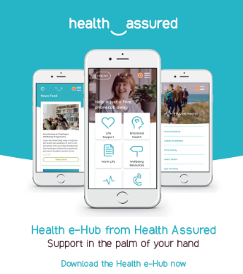
Wellbeing Resources
We’ve partnered with Health Assured to support members mental health and wellbeing
Unlimited free 24/7 confidential telephone helpline, online portal & Health e-Hub app
The resource provides:
Legal information
Debt and financial information
Manager consultancy and support
Information on work and home issues
Factsheets, advice, information and self-help tools
Links to specialist support organisations
A resources area with; programmes, videos, webinars, medical information and mini health checks.
Notes:
In recognition of the increased pressure and personal challenges many of you might currently be facing we’re launched a new Well-being helpline for the UK and Ireland. Calls are FREE and confidential. Phonelines are open 24 hours a day, 7 days a week, 365 days a year.
Work through your problems with a qualified therapist accredited by the British Association for Counselling and Psychotherapy (BACP).
Legal information services - support on a range of issues including personal, financial and legal matters.
Debt and financial information - support for issues such as debt, investments, pensions, managing money, negotiating with creditors.
Manager consultancy and support - at helping people managers to support their teams effectively.
Plus there are online resources and a well-being app you can download.

Slide 6
Menstrual health is a workplace issue

Slide 7
Rachel Suff
Senior Policy Adviser, CIPD

Slide 8
Menstruation and menstrual health support at work – current provision is very low

Slide 9
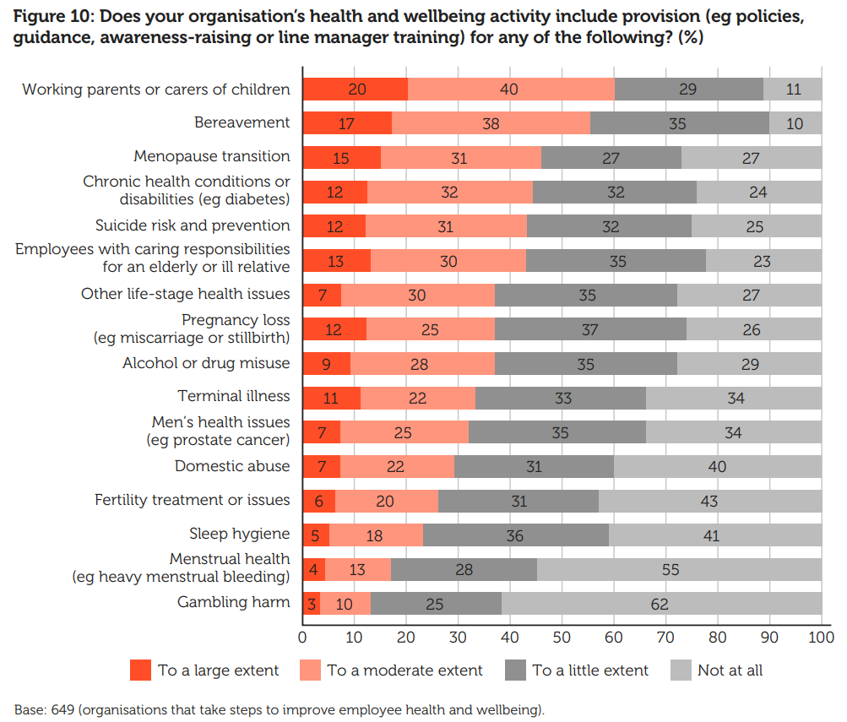
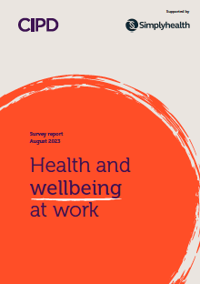

Slide 10
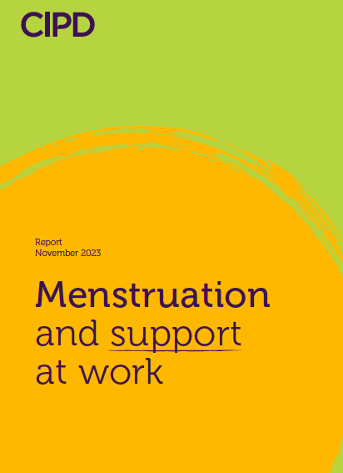
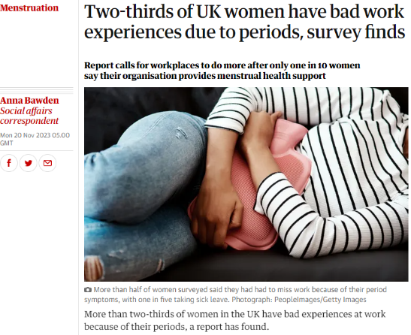

Slide 11
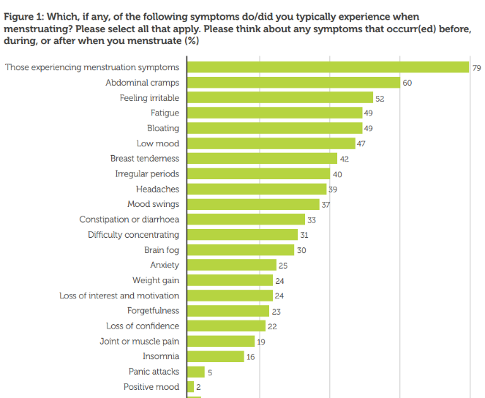
Almost 8 in 10 working women have experienced menstruation symptoms
Typical menstruation symptoms

Slide 12
Around half of employees (49%) said they never tell their manager their absence is related to their menstrual cycle
More than half (53%) had been unable to go into work at some point because of their symptoms
Main reasons they were unable to tell their manager the real reason they were unable to go into work:
they felt the problem would be trivialised
feeling embarrassed
they prefer to keep the matter private.

Slide 13
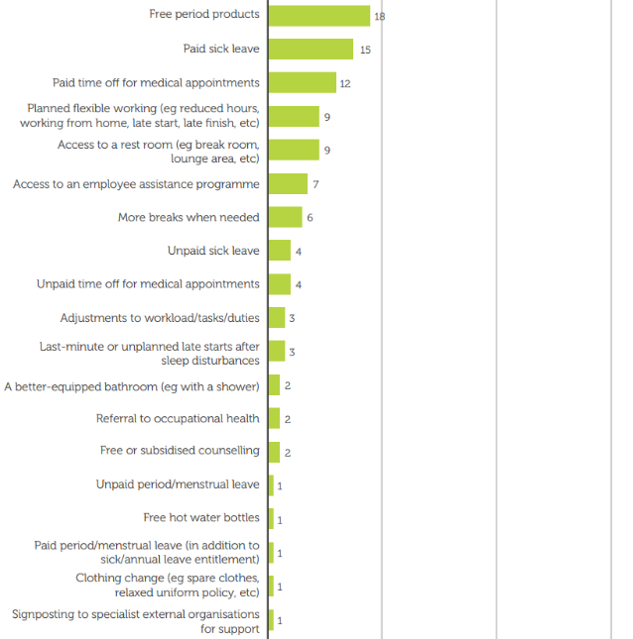
Employees want support – but only 12% of organisations provide it
Most valued types of support

Slide 14
Principles to promote good menstrual health at work
Build an open and inclusive culture
Raise awareness and tackle stigma
Offer helpful support and policies at work
Provide training and support for people managers

Slide 15
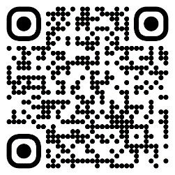
Thank you

Slide 21
then after this we need to

Slide 22
irregular /
anovulatory cycles
feel anxious and depressed
+
unable to cope with 'normal' tasks
difficulty sleeping
(tired and wired)
waking up groggy
+
energy slumps throughout the day
peri + menopausal symptoms worsen!
hair loss
bone health
cardiovascular disease
weight gain / diabetes
burnout
weakened immune system (more suseptable to illness)

Slide 23
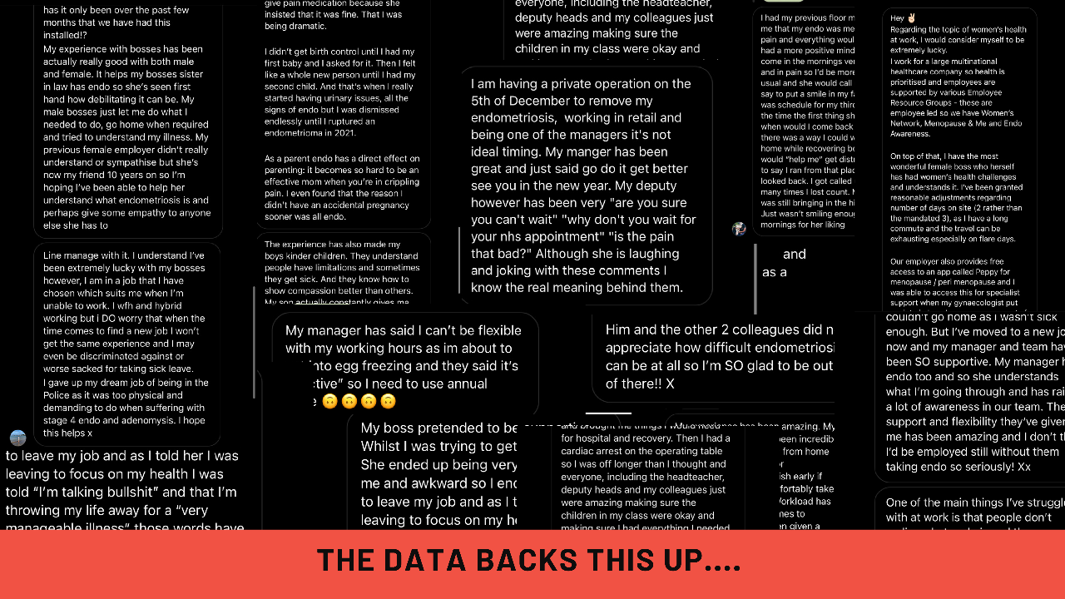

Slide 27
CIPD Case Study NCA
Well Women's Strategy
Sharon Lord: NCA Health and Wellbeing Lead
Notes:
SL

Slide 28
S.C.A.R.F Campaign is the new wrap-around forever strategic programme that describes the NCA’s commitment of support to look after the physical, psychological, environmental, financial, and spiritual wellbeing of all staff working within the NCA.
Provide the Support staff need to be happy and healthy both at work and at home
To Care about staff’s wellbeing and encourage an environment in which our people feel looked after
To Assist staff and provide the skills and knowledge needed to their job to the best of their ability
To Recognise commitment, dedication and hard work and celebrate together
To emphasise that staff are more than just a colleague, but a part of the NCA Family in which we will nurture a culture of kindness and compassion at all of our care organisations, teams and services
SCARF Folder
Health & Wellbeing Intranet Pages
QR Codes
Inform
Connect Bulletin
Colleague Experience Team & Newsletter
Where to access SCARF Information:
Notes:
SL

Slide 29
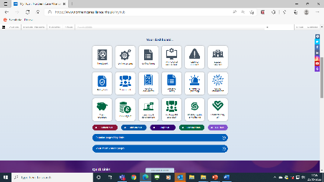
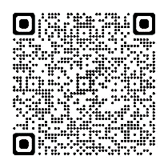
Accessing the SCARF Resources
SCARF Folder V2
Link to the SCARF Intranet Page
Download the SCARF folder on your phone
Notes:
SL

Slide 30
Physical
Financial
Offers and Discounts
Environmental
Social
Spiritual
Policies for Wellbeing
Psychological
Link to the SCARF Intranet Page
Well Women’s Strategy
PWAP
Managing Stress at Work
Flexible Working
Wellbeing and Attendance Management
Notes:
SL

Slide 31
Secondary Drivers
Primary Drivers
Menopause
PCOS + endometriosis
Fertility, Pregnancy + new mums,, breast feeding
Pregnancy Loss
Difficult Childbirth
Post Natal Depression
Sexual Health
Cancer
Mental health
Domestic violence/gender based violence
MSK
Chronic Pain
Eating Disorders
Caring Responsibilities- work/life balance ( Parents of older children MH/Social media ect)
Change Ideas
Women’s Wellbeing focus (Quality Information and Support)
Identify subject experts.
Develop a range of information and support resources
Set support grps where appropriate
Scope potential well women's clinic
Arrange webinars/external speakers
By April 2023 we will improve the wellbeing for women from 54.2% to 60% as described with our staff survey
Develop a training package to raise awareness
Embed principles within CF2/121’s/wellbeing conversations
Meaningful Conversations
Targeted Education & Training
Raising Awareness
Enabling compassionate conversations
Culture Change
Develop a standard set of Principles for the NCA women’s wellbeing strategy
Engage with National Forums (GM/UNISON/RCN)
The need to develop new policy if required
Policies and Guidance (Being responsive to women’s health needs.)
Understand National guidance.
Promote policies and guidance that enable management of conditions.
Principles for women's wellbeing connected to existing policies/guidance
Potential for new policies if required
Communication and Marketing
Communications Campaign
Social Media platforms
Support groups
Culture change
Develop strong Communications Plan with Comms colleagues
Ensure the NCA understands and is responsive to women’s wellbeing across all working ages
Achieving Potential
Flexible working
Open Transparent recruitment
Gender balance for senior positions
Inclusion in leaders teams
Clinical Excellence awards
Reduce unconscious bias
Connect with the Women’s Leader Action Group

Slide 32
Well Women’s Strategy
Trained Menopause Advocates (Henpicked) and Endometriosis Champions (Endometriosis UK ) – and developed an awareness training package inhouse
Commissioned MIST to deliver expert Pregnancy Loss Awareness sessions and donated to Fertility Network UK to deliver sessions throughout 2023.
Delivered a series of awareness sessions for Menopause, Pregnancy Loss, rescheduling Menopause and Endometriosis for 2024.
Policies developed for each focus area.
Intranet Pages developed with a wide range support, information, helplines etc.1,527 Well Women's Strategy page views since March 23 and has been the most viewed SCARF intranet page
Research Paper with MMU. MMU shared nationally, Case study with CIPD. Invited to Houses of Parliament.
QPS Survey June 23 local question asked colleagues completing the survey if they knew about the well women's strategy – 65.3% stating Yes.

Slide 33
NCA Women's Wellbeing Strategy
Notes:
SL Next Dometic Abuse

Slide 34
Awareness Sessions:
Menopause: 14 completed 2023 rescheduling for 2024 – Increased capacity to 40 due to being sold out within 4 weeks. – Inhouse training sustainability.
87% stated they felt very confident or confident to have a supportive conversation following the session. 13% a little confident. 0% Not confident
100% said they would be able to make positive changes for themselves or their colleagues.
100% would recommend to other colleagues
Pregnancy Loss: 14 sessions have been completed
100% strongly agreed or agreed stated they felt their knowledge around pregnancy loss in the workplace had improved
86% stated they felt very confident or confident to have a supportive conversation following the session. 14% a little confident. 0% Not confident
100% would recommend to other colleagues
Fertility Support at Work: 18 delivered by Fertility Network UK
92% strongly agreed or agreed stated they felt their knowledge around pregnancy loss in the workplace had improved
100% said they would be able to make positive changes for themselves or their colleagues
79% stated they felt very confident or confident to have a supportive conversation following the session. 21% a little confident. 0% Not confident
Endometriosis: Started 18th Oct 23 – Inhouse training sustainability
Domestic Abuse Colleague to Colleague awareness sessions Coming Soon
New Parent Support Development Group established.

Slide 35
Personal stories
Well Womens Fertility Support at Work
I just wanted to let you know that my IVF treatment in May was successful and I am currently around 24 weeks pregnant. The new Well Womens fertility support at work and policy made my life so much easier during treatment, knowing what support was available to me, really made a difference especially knowing the NCA’s support behind me. Before I knew the NCA was working on fertility support at work I didn’t see the point in telling anyone 'how could work possibly help in anyway'. It was your work on fertility support that changed that and I am so glad I reached out. I am so grateful for your work.

Slide 36
Next Steps
Embedding our Well Women's Strategy 2024
New Parent Support Group
Domestic Abuse Support and Sexual Safety

Slide 37
Well men's Strategy
APPG Paper started our thinking around what a well men's strategy should focus on. (No current national Mens Health Strategy – this is a call to action)
Evidence from APPG Paper: Suicide – Men make up 75% of all death by suicide and biggest cause of death for men under 50. 32, 304 men die prematurely of heart disease annually. 9.6% of man have type 1 or 2 diabetes (7.6% for women)
Andysman Club awareness Sessions – Ran by our own Alec Nicolson a Andysmans club facilitator sharing his story and promoting the suicide prevention charity: 5 sessions scheduled – each session is supporting struggling colleagues or relatives.
Target Your Health: Health checks BP/P/Blood Sugar, Macmillan, Physio, Pelvic Health, Dietitian, Bowel & Prostrate Ca, Clinician, Wellbeing Chaplain, Health Lifestyles, Hearing, Andysman club, MH support, Smoking Cessation, complementary therapies.
Bury Event Feedback
From the event do you feel info will support you to improve your own health and wellbeing. 100% agree (40% strongly agree, 60% agree)
From the event do you feel info provided will support you to signpost and support colleagues' wellbeing. 100% agree. (60% strongly agree, 40% agree)
Would you recommend this to another colleague. (100% agreed)
Total 475 interventions provided at the different stalls
14 mental health concerns, 2 serious risk to mental health, 4 x high blood pressures, 2 x diabetes type 2 suspected, 1 x atrial fibrillation ( accompanied to our A&E department for further investigation)

Slide 38
Questions
Please share any questions you have for our panellists using the Q&A tab.

Slide 39
Wellbeing Resources
We’ve partnered with Health Assured to support members mental health and wellbeing
Unlimited free 24/7 confidential telephone helpline, online portal & Health e-Hub app
The resource provides:
Legal information
Debt and financial information
Manager consultancy and support
Information on work and home issues
Factsheets, advice, information and self-help tools
Links to specialist support organisations
A resources area with; programmes, videos, webinars, medical information and mini health checks.
Notes:
In recognition of the increased pressure and personal challenges many of you might currently be facing we’re launched a new Well-being helpline for the UK and Ireland. Calls are FREE and confidential. Phonelines are open 24 hours a day, 7 days a week, 365 days a year.
Work through your problems with a qualified therapist accredited by the British Association for Counselling and Psychotherapy (BACP).
Legal information services - support on a range of issues including personal, financial and legal matters.
Debt and financial information - support for issues such as debt, investments, pensions, managing money, negotiating with creditors.
Manager consultancy and support - at helping people managers to support their teams effectively.
Plus there are online resources and a well-being app you can download.

