Slide 1
CIPD webinar series
Managing Multicultural Teams
28 June 2021

Slide 2
Welcome
Charlotte Chedeville
Senior Programme and Project Manager, CIPD Middle East

Slide 3
Today’s speakers
Jake Young
Research Associate,
CIPD
Berry Lumpkins
VP – Leadership & Talent Development,
DP World
Asif Sadiq
SVP and Head of Equity & Inclusion International, Warner Media (UK)

Slide 4
#StrongerWithCIPD
Covid-19 resources
NEW Well-being helpline
Employment Law helpline
Communities and branches
People Management
Knowledge and content
Free learning
Careers support
Professional creditability
Financial support
cipd.co.uk/memberbenefits

Slide 5
*New* Wellbeing Resources
We’ve partnered with Health Assured to support members mental health and wellbeing
Unlimited free 24/7 confidential telephone helpline, online portal & Health e-Hub app
The resource provides:
Legal information
Debt and financial information
Manager consultancy and support
Information on work and home issues
Factsheets, advice, information and self-help tools
Links to specialist support organisations
A resources area with; programmes, videos, webinars, medical information and mini health checks.

Slide 6
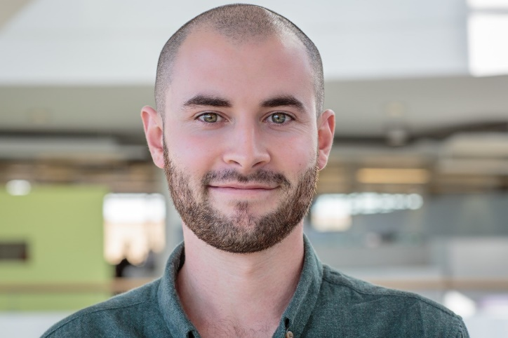
Managing Multicultural Teams
CIPD Webinar Series June 2021
Jake Young, Research Associate, CIPD
Jake.Young@cipd.co.uk
@jakeyoung500

Slide 7
The multicultural team is a growing phenomenon

Slide 9
A two-pronged research approach

Slide 10
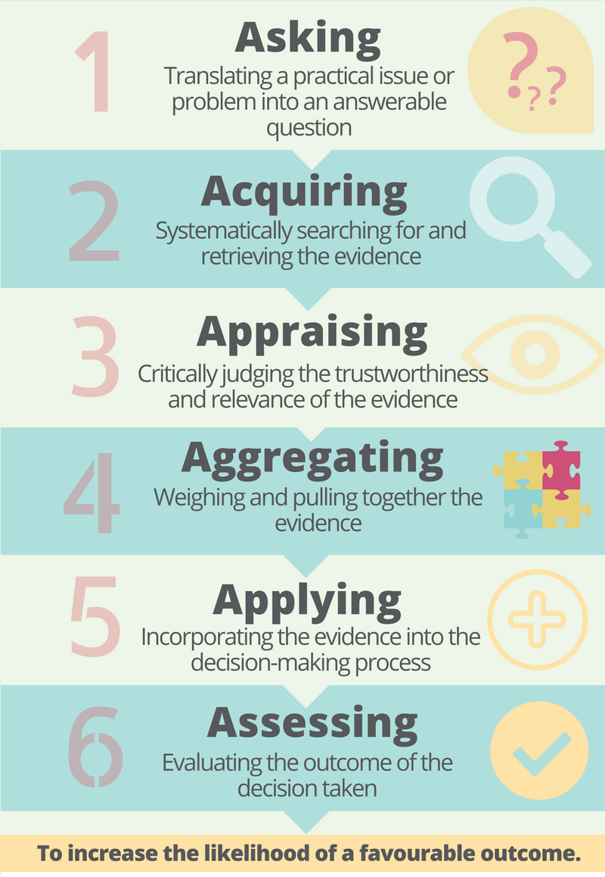
EBP is an established process…

Slide 11
Practical questions & better decisions
What are multicultural teams?
What are the benefits and challenges of multicultural teams?
The importance of cultural intelligence
Multicultural teams and COVID-19

Slide 12
What are multicultural teams?

Slide 13
What are the challenges and opportunities of multicultural teams?

Slide 14
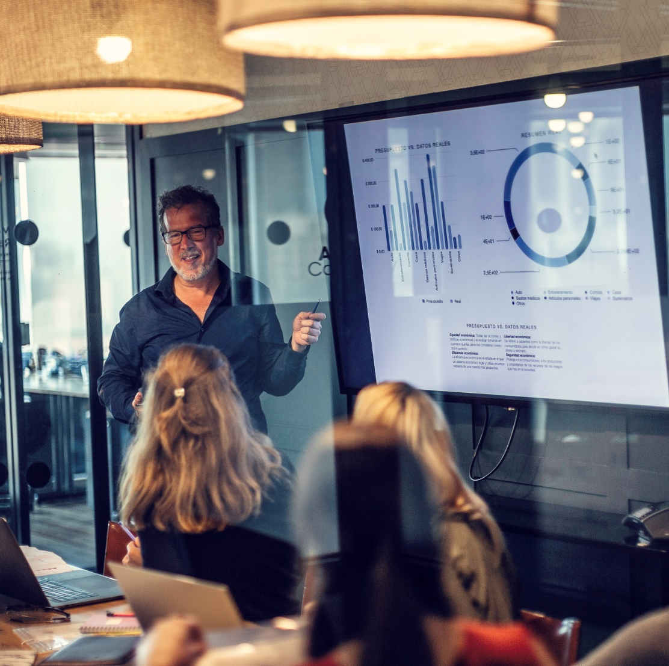
Culturally diverse teams are more creative

Slide 15
Language barriers present a challenge to effective communication

Slide 16
How important are culturally intelligent leaders?

Slide 17
Multicultural teams have faced unique challenges during the pandemic

Slide 18
Takeaways and Recommendations
Overcoming language barriers
Showing cultural intelligence to enhance creativity
Making the most of virtual working

Slide 19
Resources
Managing multicultural teams report https://www.cipd.co.uk/knowledge/fundamentals/relations/diversity/managing-multicultural-teams
Organisational culture and cultural change factsheet https://www.cipd.co.uk/knowledge/culture/working-environment/organisation-culture-change-factsheet
Diversity management that works: an evidence-based approach https://www.cipd.co.uk/knowledge/fundamentals/relations/diversity/management-recommendations

