Slide 1
CIPD Coronavirus webinar series
Solving the hybrid working challenge
26 July 2021

Slide 2
Welcome
Lesley Richards, Head of CIPD Wales

Slide 3
Today’s speakers
Lesley Richards
Head of CIPD Wales, CIPD
Peter Cheese
Chief Executive, CIPD and Co-chair of the Flexible Working Taskforce
Paul Scully
Minister for Small Business, Consumers & Labour Markets, and Minister for London
BEIS
Gary Wedderburn,
Subject Matter Expert, ACAS
Claire McCartney
Senior Policy Adviser – Resourcing and Inclusion, CIPD
Andrew Willis
Head of Legal, Croner

Slide 4
#StrongerWithCIPD
Covid-19 resources
NEW Well-being helpline
Employment Law helpline
Communities and branches
People Management
Knowledge and content
Free learning
Careers support
Professional creditability
Financial support
cipd.co.uk/memberbenefits

Slide 5
*New* Wellbeing Resources
We’ve partnered with Health Assured to support members mental health and wellbeing
Unlimited free 24/7 confidential telephone helpline, online portal & Health e-Hub app
The resource provides:
Legal information
Debt and financial information
Manager consultancy and support
Information on work and home issues
Factsheets, advice, information and self-help tools
Links to specialist support organisations
A resources area with; programmes, videos, webinars, medical information and mini health checks.

Slide 6
Gary Wedderburn
Subject Matter Expert, ACAS

Slide 7
1
Layout
4
feedback
2
How it fits together
5
More from Acas on hybrid
3
Individual subjects

Slide 8
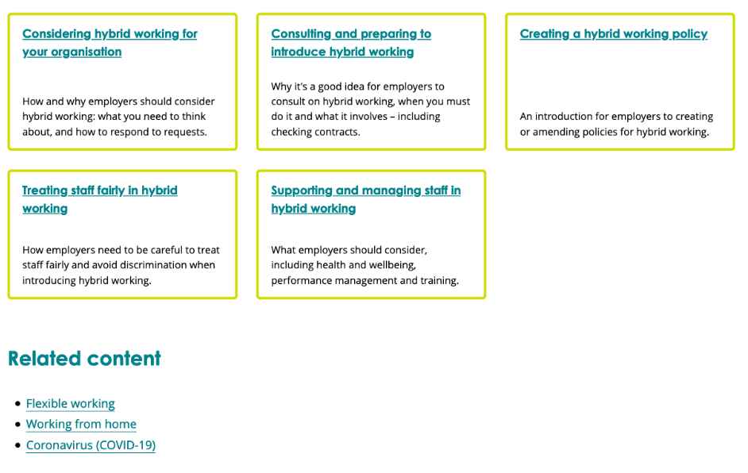
Layout of guide
Notes:
Intro to the guide and brief setting out of the sections

Slide 9
How it fits together
Flexible working
Considering hybrid working
Create a hybrid policy
Consultation
Supporting and managing
Home working
Notes:
using consultation as an example of how sections of the guide link to each other as discussion/consultation is relevant throughout rather than just at one stage
Importance of currently available Acas guidance and how it links in with hybrid working to provide extra detail and context:
Home working– linked to throughout hybrid working guide at appropriate points (e.g. supporting and managing section)
Flexible working guide – linked to full guide on responding to a flexible working request

Slide 10
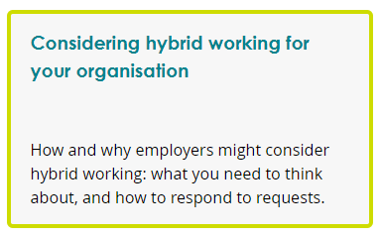
Notes:
Why you might consider hybrid working
You might look to introduce it. Balancing employee desire for some home working and business needs
Transitioning from emergency ways of working during restrictions
Request from staff
Considering how it could work for you
where, when and how
Avoiding generalising
Individual needs
Avoid assumptions and generalising
Requests
Flexible working requests
reasonable adjustments
Deciding what to do next
Fair, transparent, clearly explainable
Consider trial and review
Other types of flexible working options

Slide 11
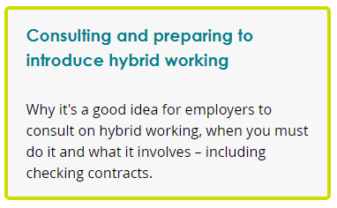
Notes:
Consultation as good practice
Useful throughout process
Build trust in process
Engage staff
When you must consult
Checking the contract
Consider whether you’ll need to change the contract
Informal, non contractual changes vs varying contract
Link to varying contract guide

Slide 12
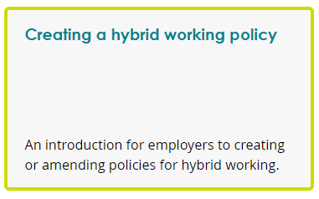
Notes:
Creating or adapting a policy for hybrid working
An introduction
What a policy is
Outline framework for how hybrid working looks in your organisation
Framework for how a decision is made on hybrid working
Reviewing a policy and consulting over policy

Slide 13
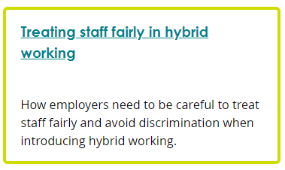
Notes:
Treating staff fairly
Including everyone regardless of where they are working
Consider discrimination and the law

Slide 14
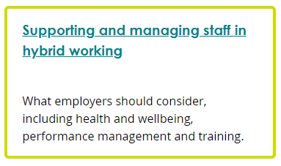
Notes:
Health, safety and wellbeing
Supporting mental health
Considering performance management
Importance of training for all involved
Important link to homeworking guide for more detail on managing staff while working from home

Slide 15
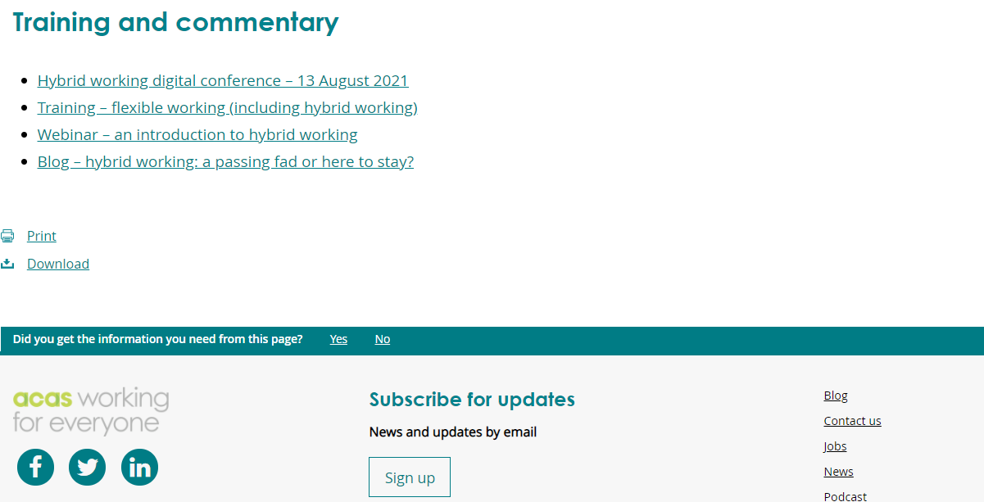
Tell us what you think
Notes:
At the bottom of every page of the guide is this button to provide feedback.
We’re eager for as much feedback as possible. This is a quickly developing area with lots of discovery, we plan to add to and iterate guidance based on experience and feedback

Slide 16
More on hybrid working from Acas
Series of webinars on hybrid working
acas.org.uk/webinars
Hybrid Working digital conference
Acas hybrid conference
Notes:
Webinars throughout August
Hybrid working conference 13th August

Slide 17
Solving the hybrid working challenge
Claire McCartney
Senior Policy Adviser, CIPD

Slide 19
The role of line managers
Support line managers to
Manage requests for hybrid
Develop the skills to ensure effective hybrid working communication & mgt
Manager responsibilities
Establish new ways of working
Engage the team about the best ways to communicate
Support fairness and inclusion
Keep a spotlight on wellbeing
Notes:
Support line managers through effective learning and development. This should two separate but related elements:
Manager responsibilities
Familiarise themselves with organisational policy and guidance on hybrid working
Discuss hybrid working with their team
Establish new ways of working
Engage the team about the best ways to communicate
Support fairness and inclusion
Keep a spotlight on wellbeing
Tips for managing hybrid teams

Slide 20
Inclusion and fairness
Access to development and career conversations for all.
Track & review data to ensure there are no unintended negative consequences.
Look at where remote/ hybrid working might be a helpful reasonable adjustment.
Ensure equality of experience between employees in the office and at home.
Notes:
In a hybrid environment, organisations must ensure ongoing access to development and career conversations for all employees and make sure there is a fair allocation of work and opportunities.
Identify areas where inequalities may have developed during the pandemic and setting out plans to address these to ensure they not have a long-term detrimental impact on individuals or the organisation.
Identify where any inclusion risks may arise if employees move to hybrid working and how these can be mitigated.
Track and review your data around recruitment, promotion, reward, retention in the light of hybrid working to ensure there aren’t any unintended negative consequences. Make adjustments where needed.
Look at where remote/ hybrid working might be a helpful reasonable adjustment for an employee with a disability or long-term health condition.
Consider all the issues where an employee might not be able to work from home (lack of private space, social isolation, incidences of domestic abuse) or in the physical workspace (clinically vulnerable, concerns over using public transport) and accommodate wherever possible.
Take steps to ensure equality of experience between employees in the office and employees at home.
Be aware of potential conflict and taking steps to ensure managers are prepared to properly manage any conflict situations.
Boosting flexible hours working arrangements for people who can’t work remotely at all

Slide 21
Wellbeing
Equip managers to have regular wellbeing conversations.
Discuss healthy use of technology & encourage people to mindfully disconnect.
On-going access to mental health support/ information
Help mgrs to spot signs of poor wellbeing or mental health.

Slide 23
Questions
Please submit your questions for:
Claire McCartney, Senior Policy Adviser – Resourcing and Inclusion, CIPD
Gary Wedderburn, Subject Matter Expert, ACAS
Andrew Willis, Head of Legal, Croner
Please use the Q&A function to submit your questions

Slide 24
#StrongerWithCIPD
Covid-19 resources
NEW Well-being helpline
Employment Law helpline
Communities and branches
People Management
Knowledge and content
Free learning
Careers support
Professional creditability
Financial support
cipd.co.uk/memberbenefits

