Slide 1
CIPD webinar series
Supporting your people through times of crisis
17 March 2022

Slide 2
Welcome
Lesley Richards
Head of CIPD Wales

Slide 3
Today’s speakers
Lesley Richards
Head of CIPD Wales, CIPD
Peter Cheese,
Chief Executive,
CIPD
Rachel Suff
Senior Employee Relations Adviser, CIPD
Tony Jamous
CEO,
Oyster
Louise Haycock,
Partner,
Fragomen

Slide 4
#StrongerWithCIPD
Covid-19 resources
NEW Well-being helpline
Employment Law helpline
Communities and branches
People Management
Knowledge and content
Free learning
Careers support
Professional creditability
Financial support
cipd.co.uk/memberbenefits

Slide 5
*New* Wellbeing Resources
We’ve partnered with Health Assured to support members mental health and wellbeing
Unlimited free 24/7 confidential telephone helpline, online portal & Health e-Hub app
The resource provides:
Legal information
Debt and financial information
Manager consultancy and support
Information on work and home issues
Factsheets, advice, information and self-help tools
Links to specialist support organisations
A resources area with; programmes, videos, webinars, medical information and mini health checks.

Slide 6
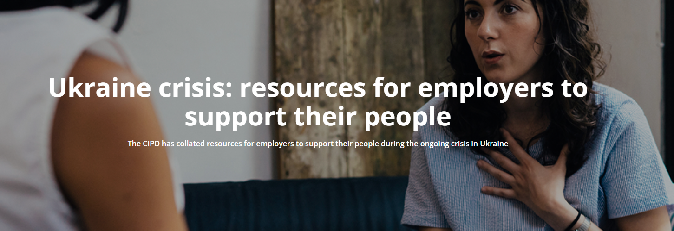
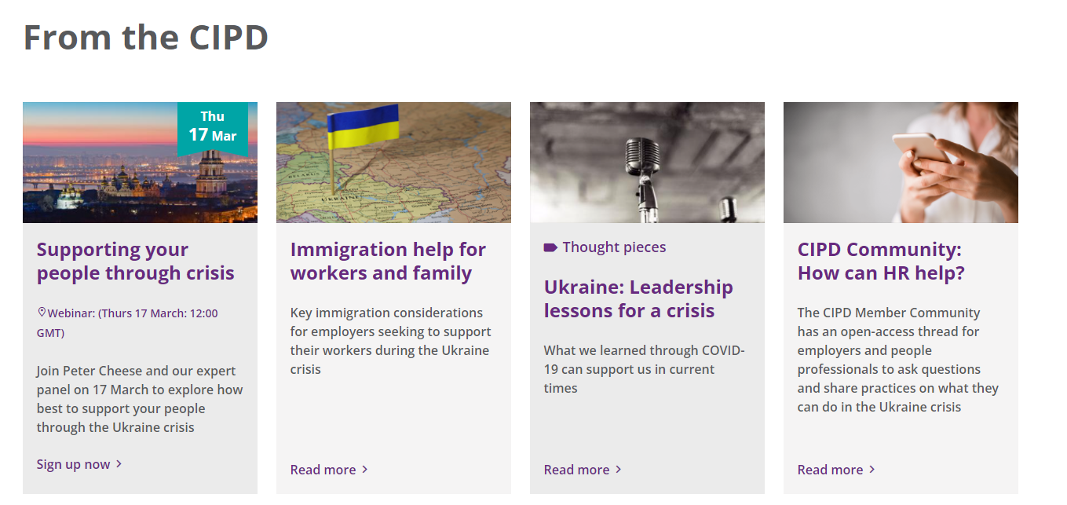
cipd.co.uk/knowledge/fundamentals/people/ukraine-crisis

Slide 7
UKRAINIAN NATIONALS IN THE UK AND EU
Louise Haycock - March 2022

Slide 8
The question of where to go?
Setting the Scene
Ukrainians in the Ukraine
Information of crossing the border is here
Onwards destinations for those leaving Ukraine
EU arrangements
UK arrangements
Russians

Slide 9
Questions
Please submit your questions for:
Rachel Suff, Senior Employee Relations Adviser, CIPD
Tony Jamous, CEO, Oyster
Louise Haycock, Partner, Fragomen
Please use the Q&A function to submit your questions

Slide 10
*New* Wellbeing Resources
We’ve partnered with Health Assured to support members mental health and wellbeing
Unlimited free 24/7 confidential telephone helpline, online portal & Health e-Hub app
The resource provides:
Legal information
Debt and financial information
Manager consultancy and support
Information on work and home issues
Factsheets, advice, information and self-help tools
Links to specialist support organisations
A resources area with; programmes, videos, webinars, medical information and mini health checks.

Slide 11
cipd.co.uk/knowledge/fundamentals/people/ukraine-crisis

